Slide 1


Slide 2
THE TEAM MEMBERS ARE :
ATTA KUMAR : 720131605200(team leader)
BODDETI NISHITHA PRAKASHINI:720131605206
BANDI VANAJA : 720131605201
BARLA PALLAVI : 720131605203
BITRA SHREE ADITYA : 720131605205

Slide 3
FOREST ESSENTIALS
Brand Mission:
That is the Ayurvedic & Forest Essentials standard for pure, fresh and natural. We believe that beauty products made of living substances such as plants or their extracts, are balanced by nature and contain the vibratory energy that constitutes life. These contain all the purifying, nutritive and balancing properties necessary to nurture the skin and for eternal beauty. They are the perfect foods for the skin.
Brand Values:
Brand value is a form of repeat purchasing behavior reflecting a conscious decision to continue buying the same brand. This means that the consumer has a positive attitude towards the brand. He/she is interested in buying products from that particular brand because of belief or trust of the person for the brand.

Slide 4
Brand Vision:
The Forest Essentials standard for beauty was always pure, fresh, seasonal and natural. Across all our products, we control the conception, formulation, manufacturing and sale of our Ayurvedic products, thereby ensuring quality & purity across all pillars.
USP:
The USP of forest essentials is that the products are not made in factories. They are made in Himalayas, in villages in Uttaranchal-hub of Ayurveda, using local labor. The spring water of forest essentials is the main products of this brand. It has therapeutic and regenerative qualities and has been certified by laboratories in France as being rich in minerals deposit, which are its unique properties. This water is used in all products of Forest Essentials. It is sourced from the heart of the forest.

Slide 5
ANALYSE THE BRAND MESSAGING
Since Forest Essentials is a local Indian company trying to enter the international market, it is important that the green marketing and promotions be effectively targeted at the right audience. Unsuccessful or badly communicated brand attributes can result in the failure a product that is actually in essence ecological (Hawkins & Mothersbaugh, 2006). Promotion plan: The priority of this plan should be “To communicate without excess” meaning that information on the green initiatives should be available, however there shouldn’t be an overdose of it. If the communication goes too green, it might ruin the company’s image.

Slide 6
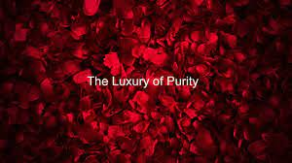
EXAMINE THE BRAND TAGLINE

Slide 7


COMPETITOR ANALYSIS
Competitor 1:
The brand leverages the rising demand of adding organic products in day to day skin and hair care routine. They are one of the first brands which deal with non-toxic seals for cosmetic products in use. This makes them a real game -changer and customer preferred name in the cosmetic and skincare industry.

Slide 8
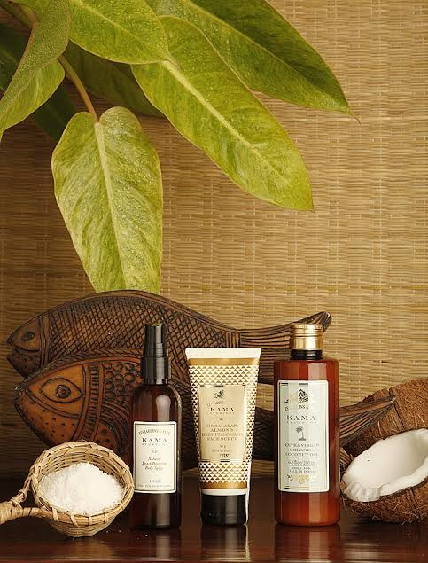

Competitor 2:
Kama Ayurveda offers high quality, beautifully packaged, Ayurvedic and natural beauty and wellness products that are used by some of the world's leading hotels and spas in India, USA and Europe. The hotels includes The Aman, Oberoi, Park, Jaypee and Claridges groups in India.

Slide 9
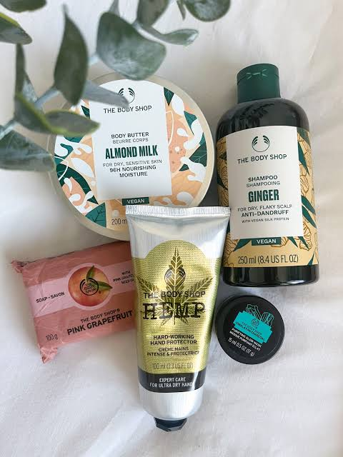

Competitor 3:
The Body Shop exists to fight for a fairer, more beautiful world. This is our purpose, and it drives everything we do. Our beliefs are everything to us: that business is a force for good, the empowerment of women and girls and the belief that everyone is beautiful.

Slide 10
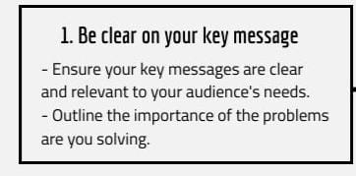
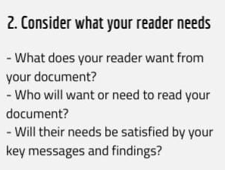
AUDIENCE’S PERSONA

Slide 11
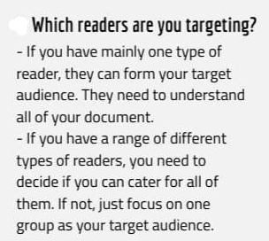
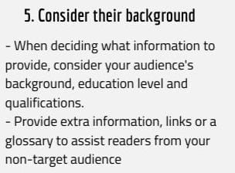

Slide 12
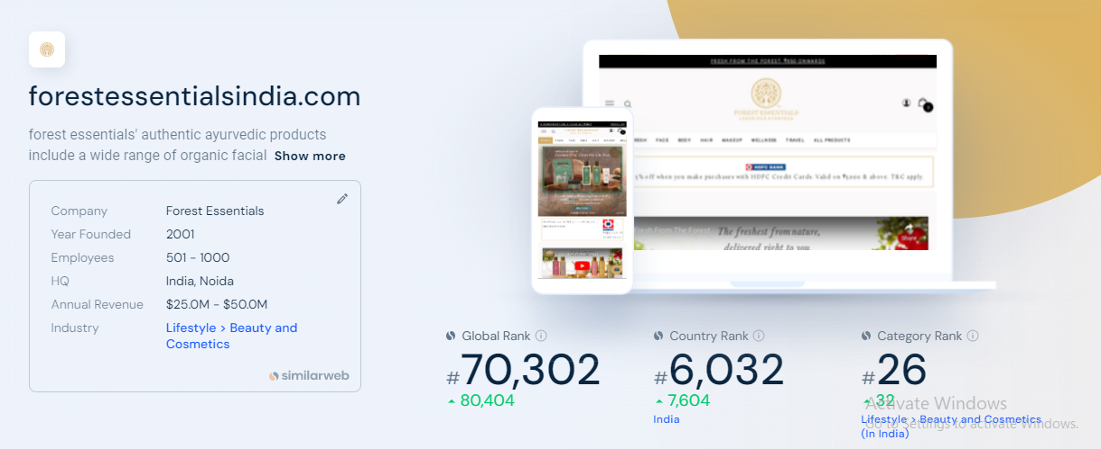
SEO AUDIT

Slide 13
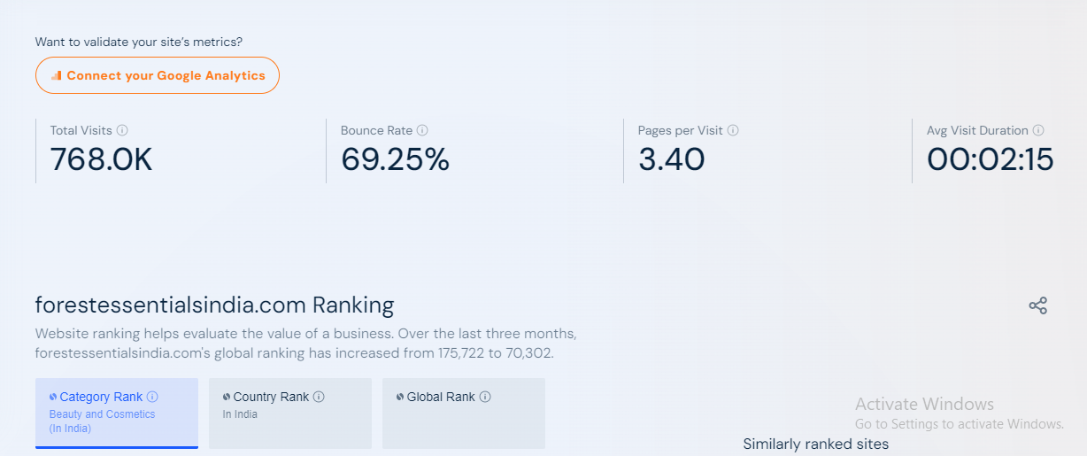

Slide 14
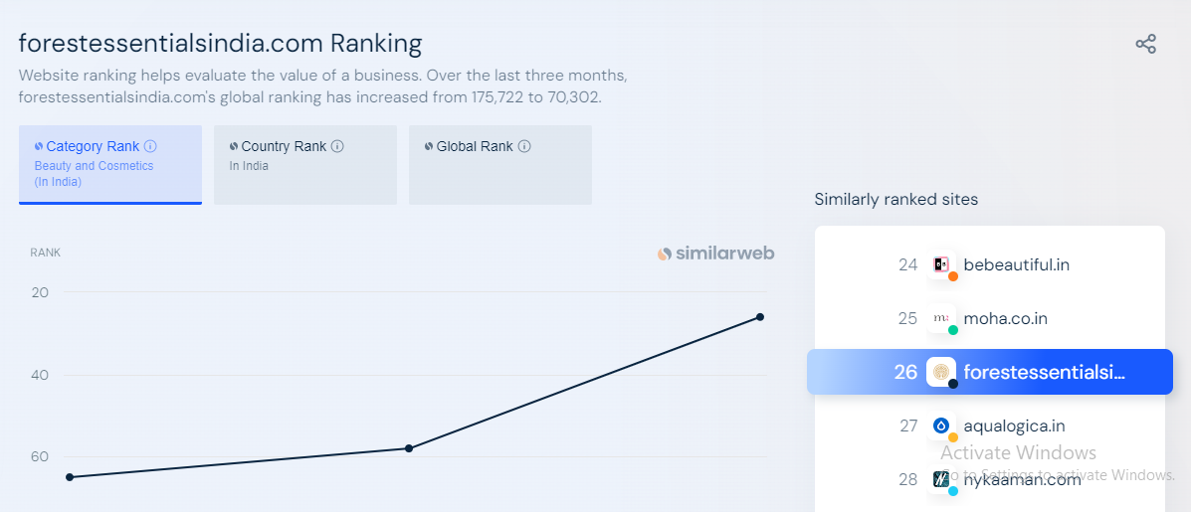

Slide 15
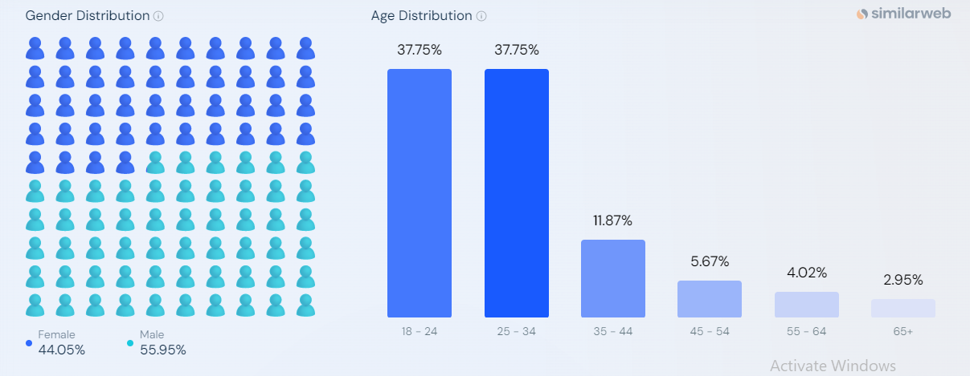
AUDIENCE DEMOGRAPHICS

Slide 16
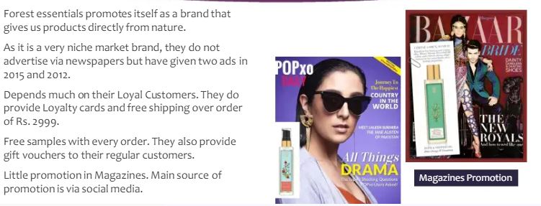
CONTENT IDEAS & MARKETING STRATEGIES

Slide 17

CONTENT CATEGORY

Slide 18
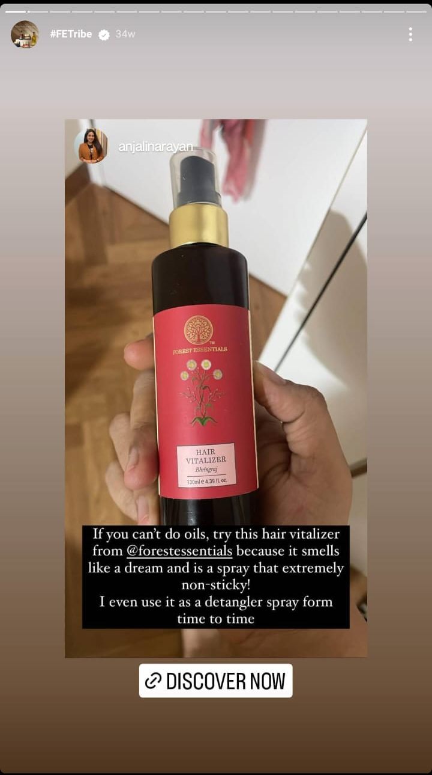
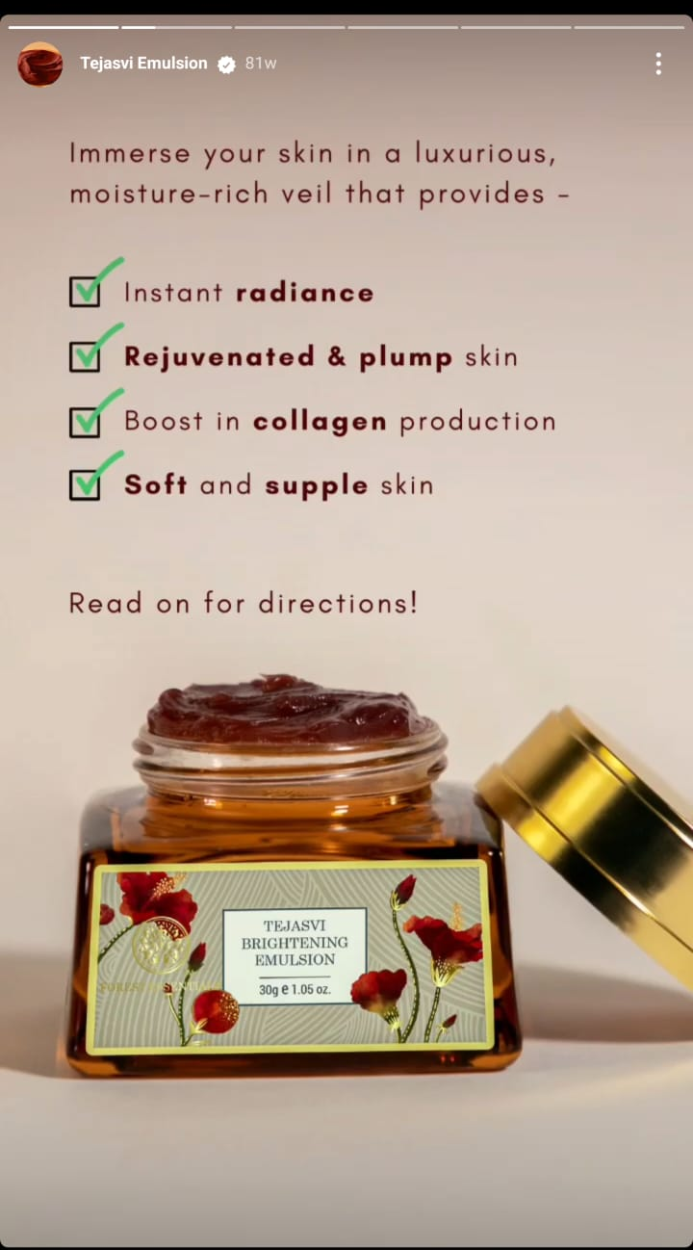
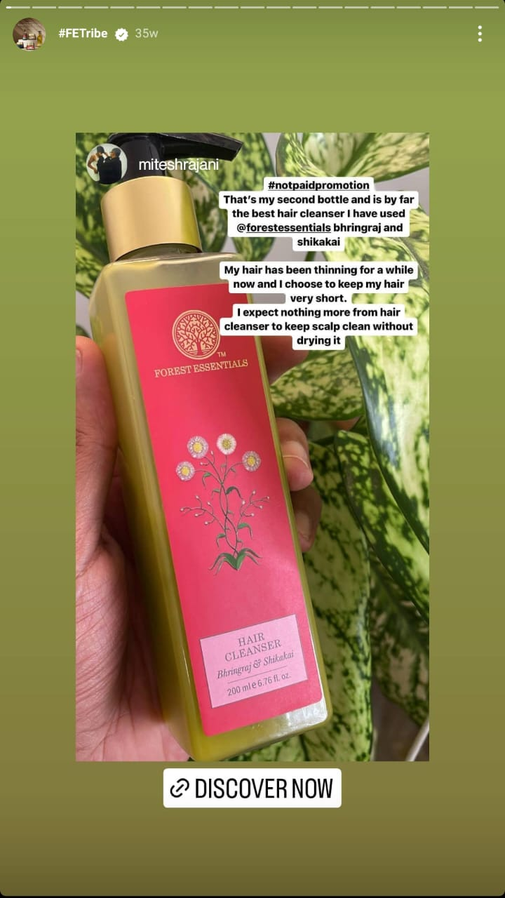
INSTAGRAM STORY

Slide 19

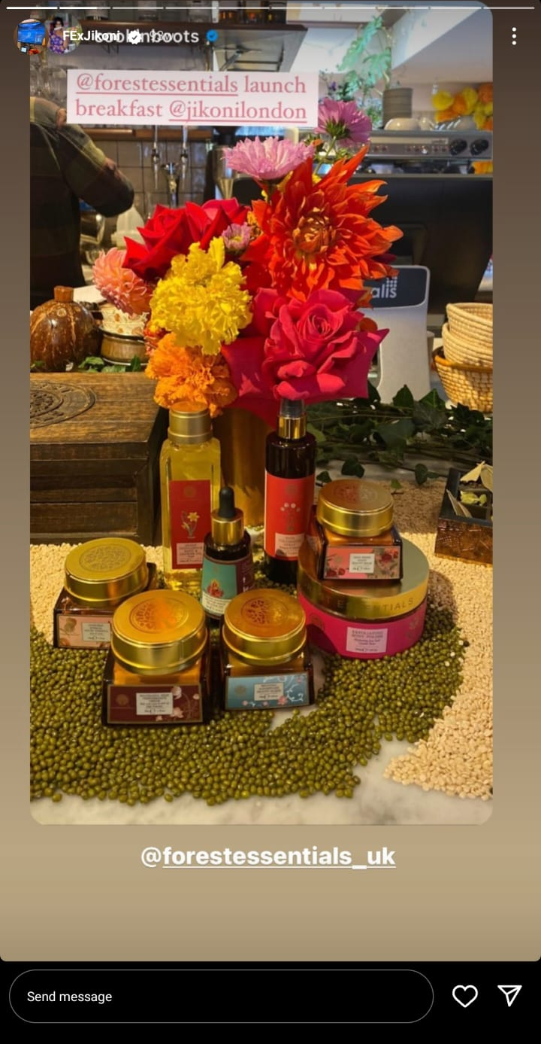
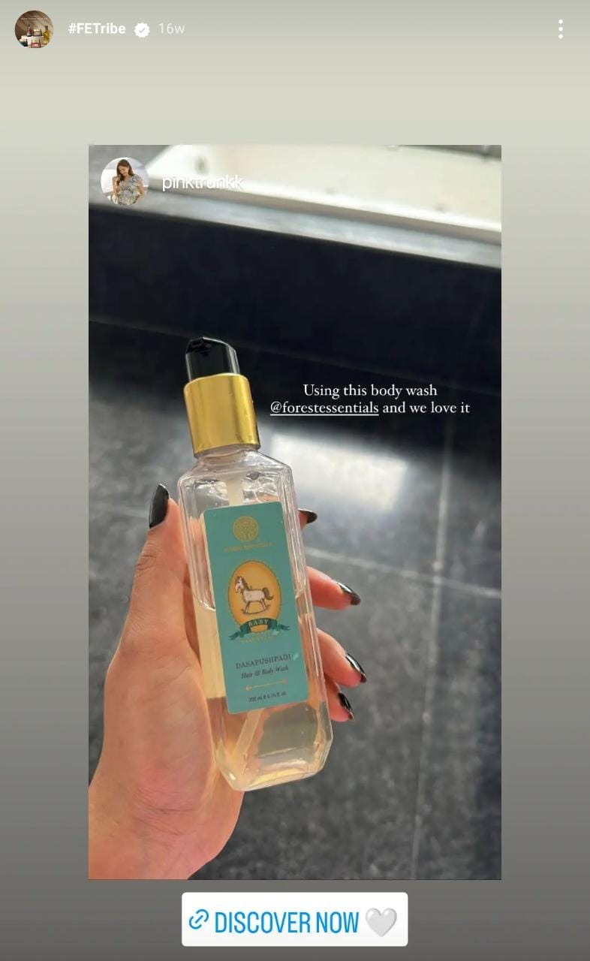
INSTAGRAM STORY

Slide 20
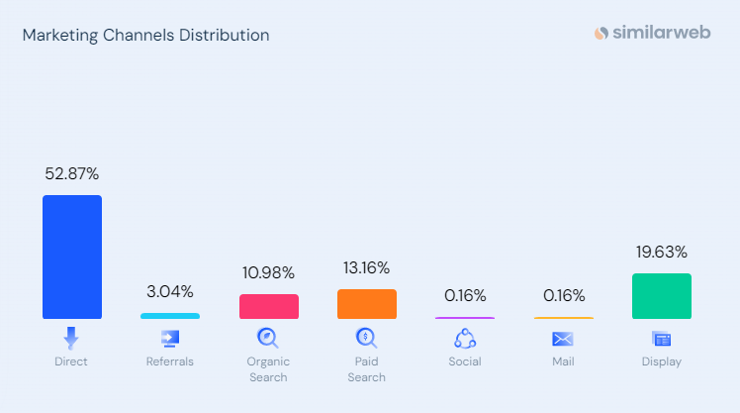
SOCIAL MEDIA AD CAMPAIGN

Slide 21

SOCIAL MEDIA AD CAMPAIGN

Slide 22


